Slide 1
Chiba Campaign 2019 TROPOMI NO₂ maps
Irie Laboratory Hikaru Saito(B4)

Slide 2
Recent Change
Improve coastlines

Slide 3
NO₂ by TROPOMI & 4AZ-MAXDOAS

Slide 4
United Scale(同一スケール)

Slide 5
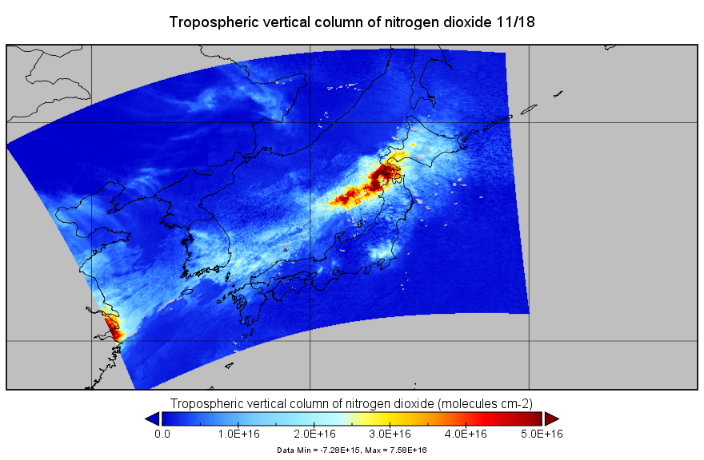
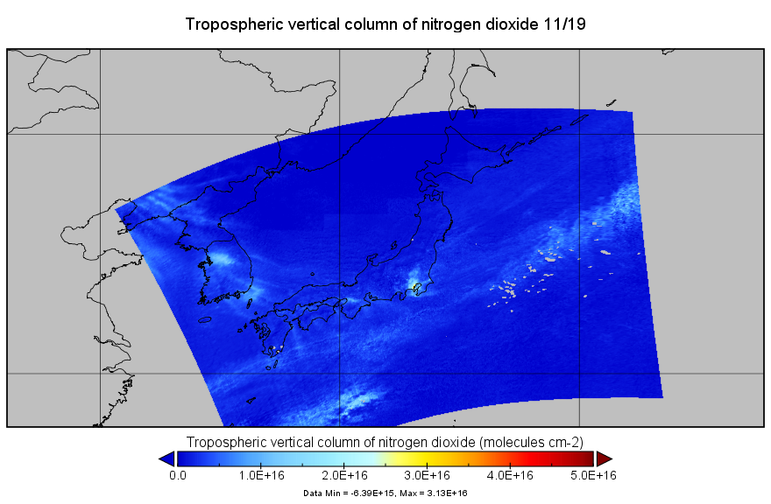
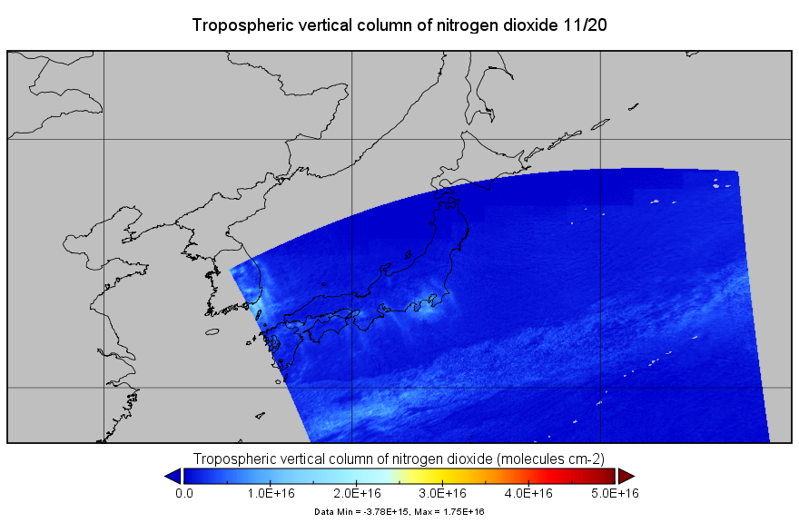
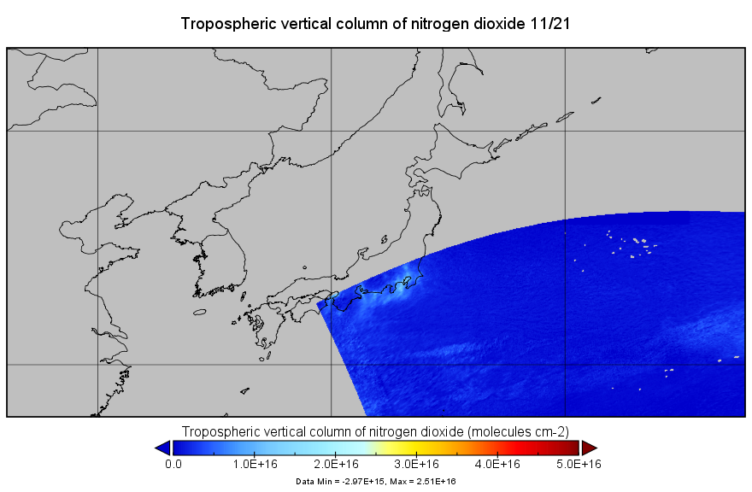

Slide 6
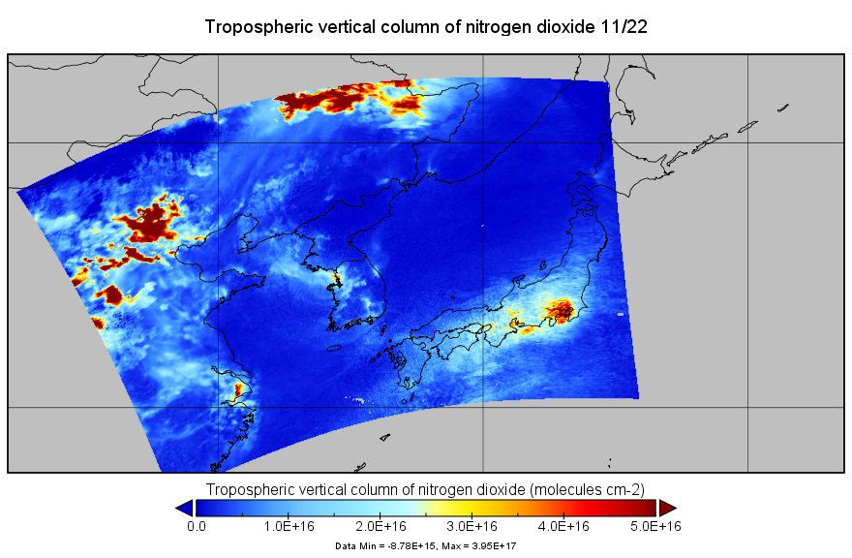
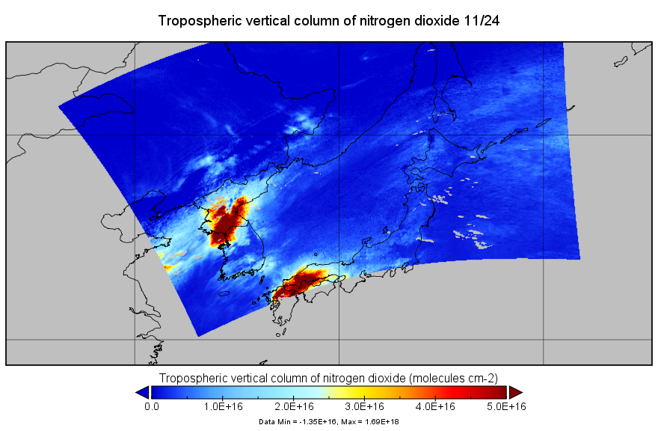
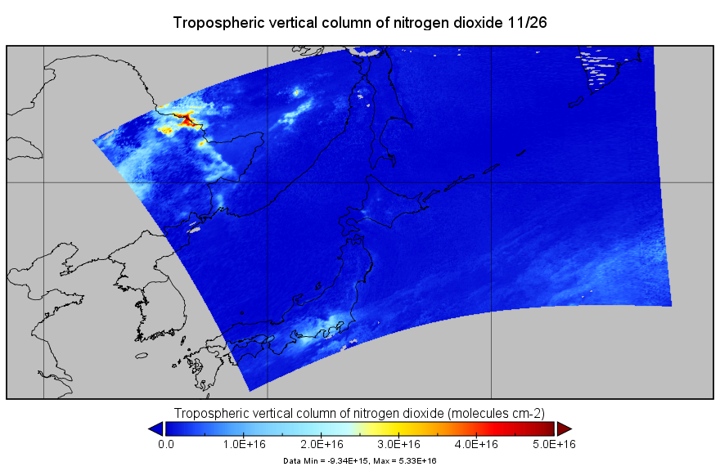
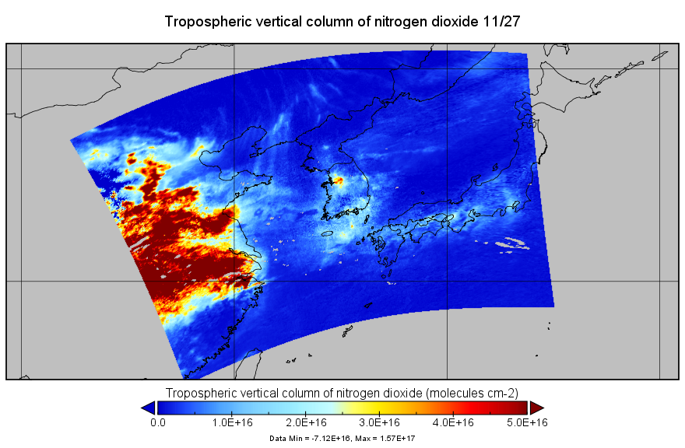

Slide 7
Individual Scale(各日異なるスケール)

Slide 9
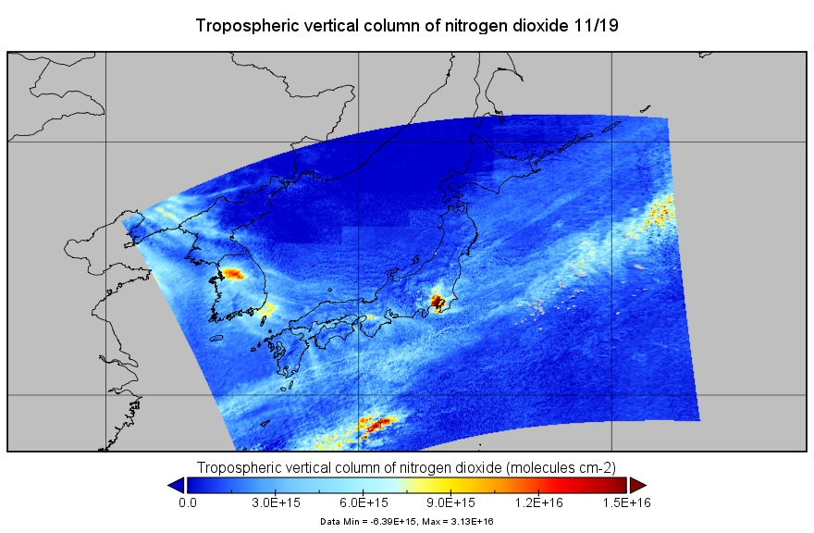

Slide 10
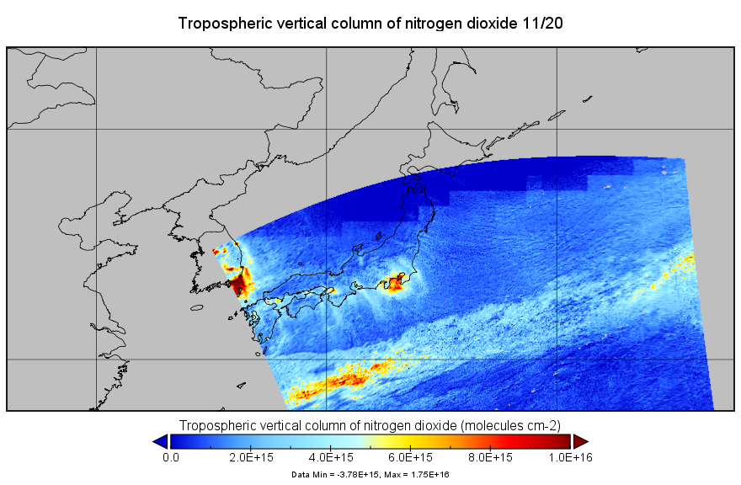

Slide 11
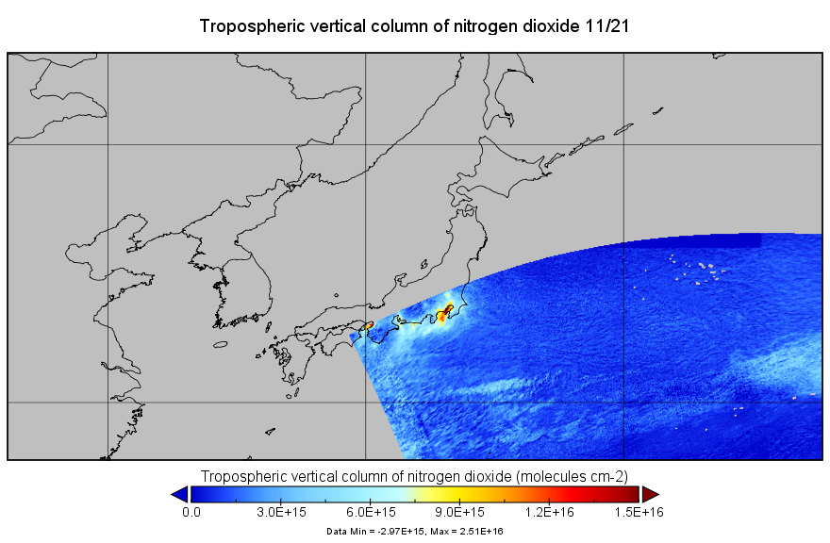

Slide 14
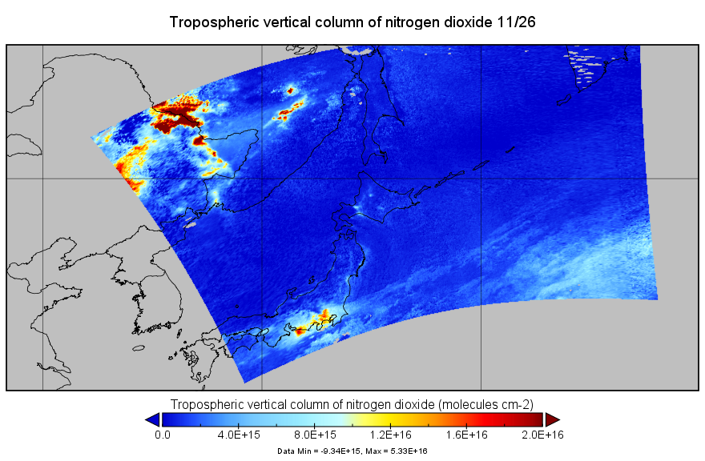

Slide 15
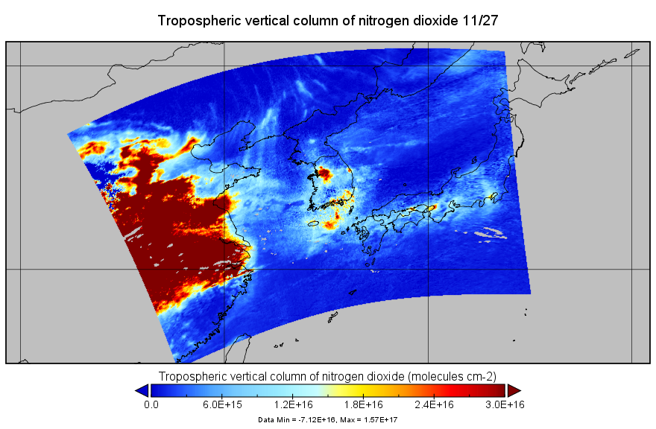

Slide 16
References
TROPOMI data
https://s5phub.copernicus.eu/dhus/#/home
S5P_NRTI_L2__NO2____20191118T040514_20191118T041014_10864_01_010302_20191118T044615.nc
S5P_NRTI_L2__NO2____20191119T034514_20191119T035014_10878_01_010302_20191119T042855.nc
S5P_NRTI_L2__NO2____20191120T032514_20191120T033014_10892_01_010302_20191120T040925.nc
S5P_NRTI_L2__NO2____20191121T030514_20191121T031014_10906_01_010302_20191121T034942.nc
S5P_NRTI_L2__NO2____20191122T043014_20191122T043514_10921_01_010302_20191122T051325.nc
S5P_NRTI_L2__NO2____20191124T035344_20191124T035844_10949_01_010302_20191124T081446.nc
S5P_NRTI_L2__NO2____20191126T031555_20191126T032055_10977_01_010302_20191126T035755.nc
S5P_NRTI_L2__NO2____20191127T043555_20191127T044055_10992_01_010302_20191127T051849.nc

